Slide 1
AUSTRALIA’S CONTRIBUTIONS TO INTERNATIONAL CLIMATE ACTION
INTERNATIONAL CLIMATE ENGAGEMENT
Notes:
The guest presenter of this video is Peter Onorato, Policy Officer, Climate Innovation and Investment Section.

Slide 2
TECHNOLOGY, INVESTMENT, INNOVATION
Notes:
Much of our work falls under a broad theme of "Technology, investment, innovation". Australia's scientific minds are among the world's best and our contributions to developing low emissions technologies and sharing our knowledge with partners are significant elements of our engagement.

Slide 3
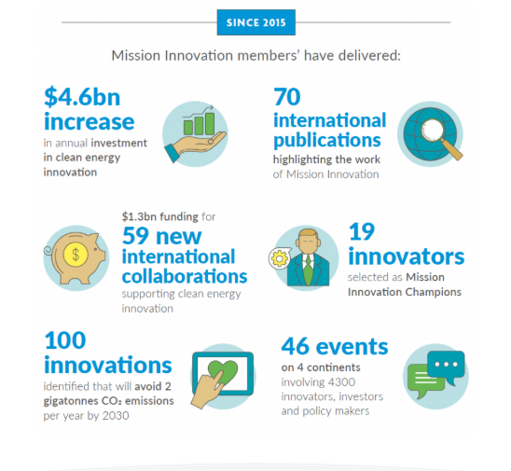
MISSION INNOVATION
A global intergovernmental initiative working to accelerate clean energy innovation.
Notes:
Mission Innovation
http://mission-innovation.net/
A global intergovernmental initiative working to accelerate clean energy innovation.
25 members are working to stimulate innovation with the objective to make clean energy more widely affordable.
Australia has pledged to double government clean energy research and development expenditure on 2015 levels by financial year 2020-21 while encouraging greater levels of private sector investment in transformative clean energy technologies.
Member achievements were highlighted at the Fourth Mission Innovation Ministerial (http://mission-innovation.net/events/fourth-mission-innovation-ministerial-mi-4/) and previewed in Mission Innovation The Story So Far: Impact Report, May 2019 (http://mission-innovation.net/wp-content/uploads/2019/05/MI-Impact-Review-May-2019.pdf)

Slide 4
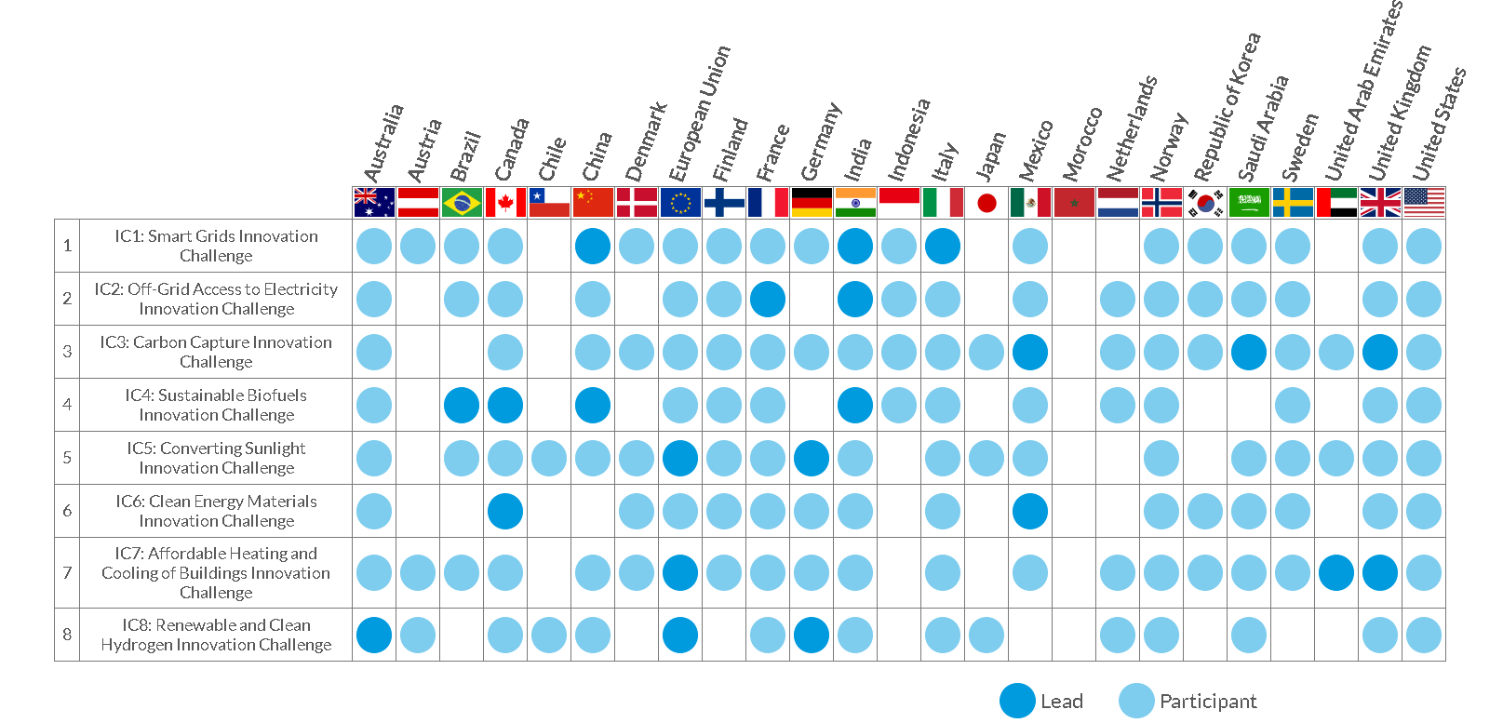
MISSION INNOVATION
Notes:
Australia’s role in Mission Innovation
http://mission-innovation.net/our-members/australia/
Australia led the establishment of the Renewable and Clean Hydrogen Innovation Challenge (IC8), in partnership with the European Commission and Germany, to address the need for further technology improvements to enable hydrogen to be cost-competitive in the energy system.
The Challenge is supporting this objective by getting like-minded countries to work together to identify and overcome key technology barriers to the production, distribution, storage and use of hydrogen at scale. See the dedicated presentation on hydrogen by my colleague Penelope Howarth for an overview of this opportunity for Australia.

Slide 5
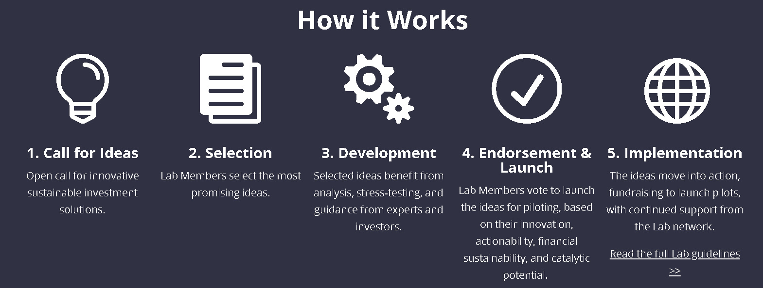
GLOBAL INNOVATION LAB FOR CLIMATE FINANCE
Notes:
Global Innovation Lab for Climate Finance
https://www.climatefinancelab.org
Responding to climate change requires trillions of dollars of investment from all sources. Public finances can play a catalytic role by crowding in private finance and leveraging investment far greater than public finance alone can achieve.
The Global Innovation Lab for Climate Finance was developed in 2014 in partnership with major development finance institutions, key private sector actors, and several climate finance donor governments. The Global Lab was created to identify and develop innovative instruments that could drive private finance for climate mitigation and adaptation in developing countries.
Since 2014, the Lab has helped launch 41 instruments that have collectively mobilised more than US$2 billion.

Slide 6
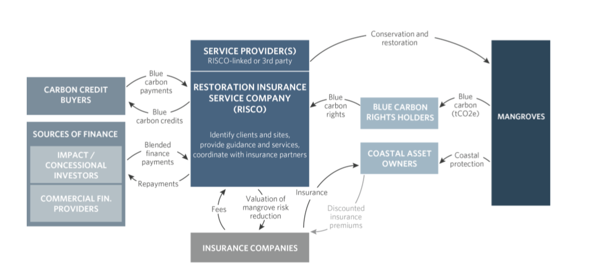
GLOBAL INNOVATION LAB FOR CLIMATE FINANCE
Australia’s Role
Blue carbon – Restoration Insurance Service Company for Coastal Risk Reduction (RISCO)
Notes:
RISCO
https://www.climatefinancelab.org/project/coastal-risk-reduction/
Monetizing Cost Savings for Water and Nature Based Solutions
https://www.climatefinancelab.org/project/monetizing-cost-savings-for-water-and-nature-based-solutions/

Slide 7
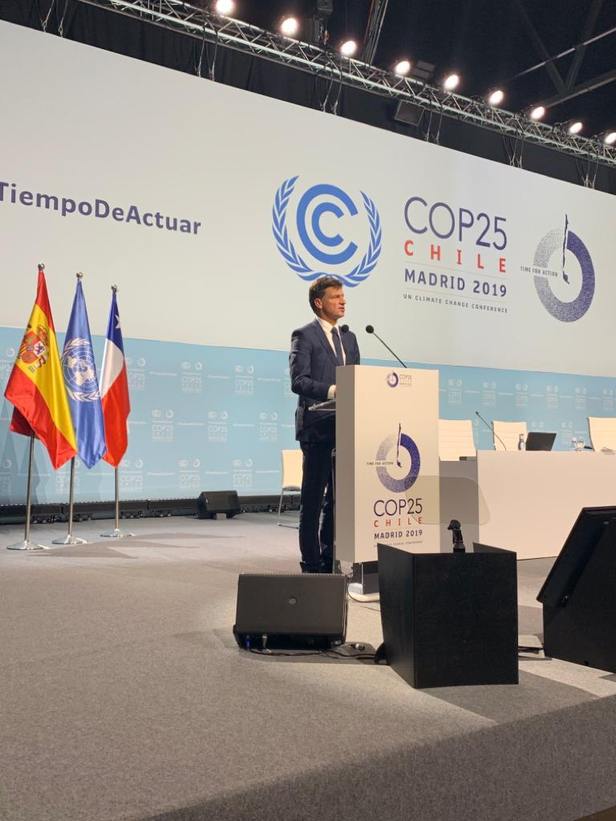
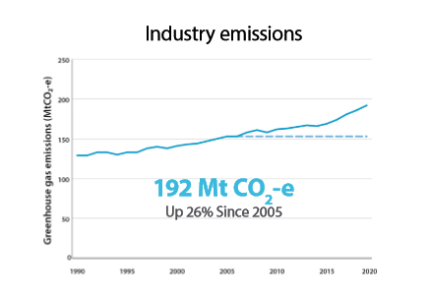
LEADERSHIP GROUP FOR INDUSTRY TRANSITION
Launched September 2019
Support transition of heavy industry to net zero emissions by 2050
Notes:
Leadership Group for Industry Transition
https://www.industrytransition.org/
Industry emissions graph – sourced from Industry Sector Fact Sheet, Climate Change Authority, 2020
http://www.climatechangeauthority.gov.au/sites/prod.climatechangeauthority.gov.au/files/Updated%20Toolkit%202020/CC276D.0120%20CCA%20FS_FA%20.pdf
Image source
https://twitter.com/AngusTaylorMP/status/1204540722315022336/photo/2
Australia's national statement at COP25
https://www.minister.industry.gov.au/ministers/taylor/transcripts/national-statement-cop25-madrid

Slide 8
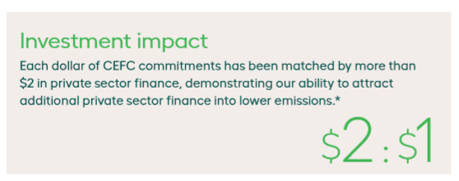
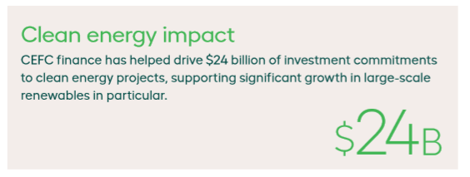
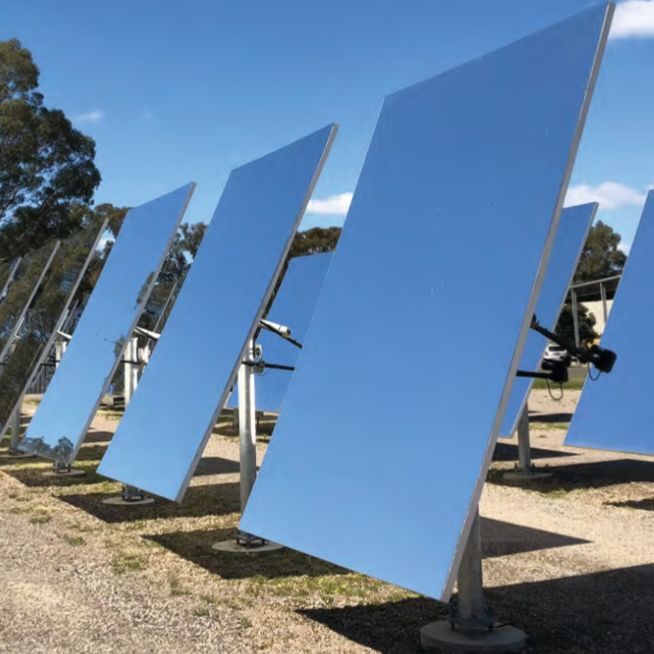
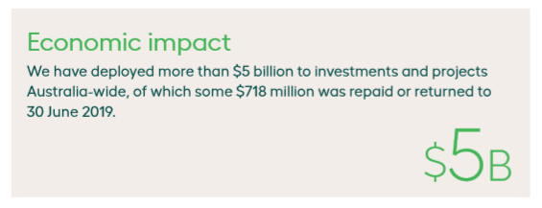
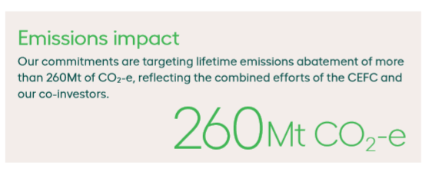
CLEAN ENERGY FINANCE CORPORATION
World’s biggest green bank
Driving private finance flows
Positive financial return
Reducing emissions
Notes:
The Clean Energy Finance Corporation
https://www.cefc.com.au/
Figure 5: CEFC performance – sourced from the CEFC 2018-19 Annual Report
https://annualreport2019.cefc.com.au/media/1428/cefc_annual_report_2018-19.pdf
Images sourced from the CEFC 2018-19 Annual Report
https://annualreport2019.cefc.com.au/media/1428/cefc_annual_report_2018-19.pdf

Slide 9
“The fact Australia leads the world in per capita investment in clean energy, we have the world’s most successful green bank in the Clean Energy Finance Corporation and that we’re on track to have around a quarter of our electricity needs met by renewables by 2020 all underscores the work underway to reduce our global emissions.”
Prime Minister Hon Scott Morrison MP
Notes:
Quote sourced from the CEFC 2018-19 Annual Report
https://annualreport2019.cefc.com.au/media/1428/cefc_annual_report_2018-19.pdf

Slide 10
AUSTRALIAN RENEWABLE ENERGY AGENCY
Notes:
ARENA website
https://arena.gov.au/

Slide 11
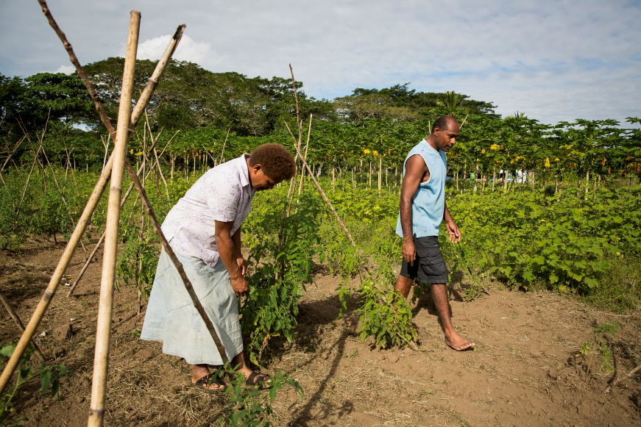
AUSTRALIAN CENTRE FOR INTERNATIONAL AGRICULTURAL RESEARCH
Case study:
Climate-smart landscapes for promoting sustainability of Pacific Island agricultural systems
Notes:
ACIAR website
https://www.aciar.gov.au/
Climate smart landscapes project page
https://www.aciar.gov.au/project/ASEM-2016-101
Climate smart landscapes fact sheet
https://www.aciar.gov.au/sites/default/files/project-page-docs/fact_sheet_asem_2016_101_a.pdf

Slide 12
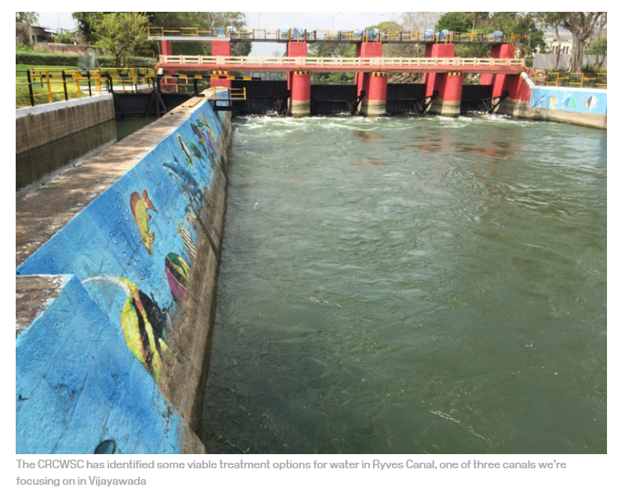
AUSTRALIAN WATER PARTNERSHIP
Case study:
Andhra Pradesh-Australia Water Sensitive Cities Partnership
Notes:
Australian Water Partnership
https://waterpartnership.org.au/
Case study - Andhra Pradesh-Australia Water Sensitive Cities Partnership
https://watersensitivecities.org.au/content/were-improving-water-quality-in-vijayawada-india/
DFAT Secretary Frances Adamson’s speech on the water-food-energy nexus
https://www.crawfordfund.org/wp-content/uploads/2019/06/01-Sir-John-Crawford-Address-2018-conference-hires.pdf

Slide 13
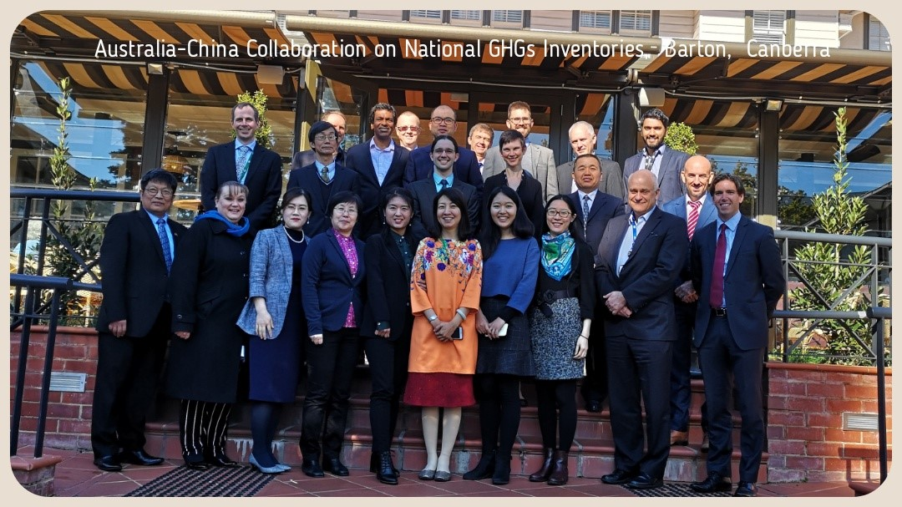
AUSTRALIAN GREENHOUSE GAS EMISSIONS INFORMATION SYSTEM
Notes:
Australia-China Collaboration on National GHGs Inventories image sourced from the Department of Industry, Science, Energy and Resources
Australia-Thailand Collaboration image sourced from - the Australian Greenhouse Gas Emissions Information System (AGEIS), 2nd CGE Pilot Informal Forum, 2019
https://unfccc.int/sites/default/files/resource/Australia%20AGEIS%20COP25_informal%20forum_for%20upload.pdf

Slide 14
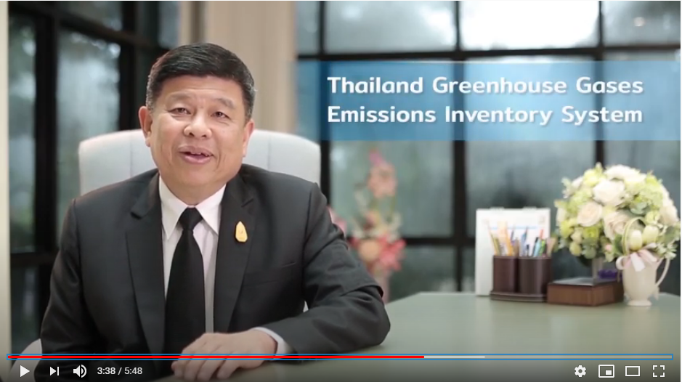
AUSTRALIAN GREENHOUSE GAS EMISSIONS INFORMATION SYSTEM
Case Study – Partnership with Thailand
Search YouTube for ‘TGEIS’ to watch a short video on the Thailand Greenhouse Gas Emissions Inventory System.
Or go to: https//youtu.be/GdFSyYdruoc
Notes:
Youtube link
https://youtu.be/GdFSyYdruoc

Slide 15
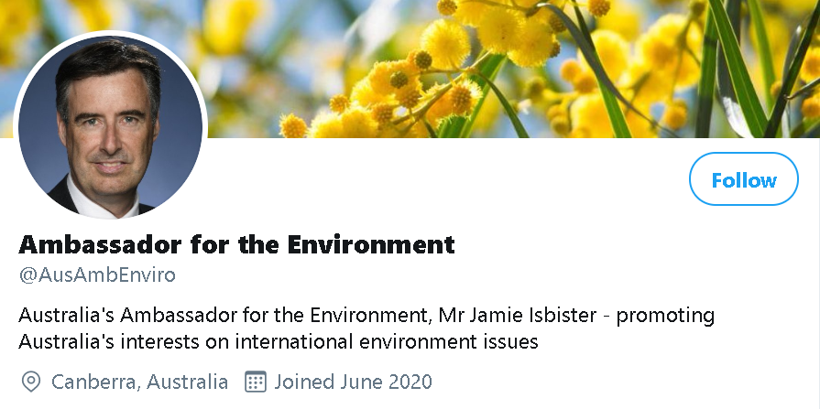
FOLLOW ON TWITTER
Follow …
Notes:
Twitter link
https://twitter.com/AusAmbEnviro

