Slide 1
INTERNATIONAL POLICY
& STRATEGIES FACULTY
CLIMATE IMPACTS
CLIMATE SCIENCE, RISK AND ADAPTATION PATHWAYS

Slide 2
PARIS AGREEMENT
The Paris Agreement is an agreement within the United Nations Framework Convention on Climate Change (UNFCCC), dealing with greenhouse-gas-emissions mitigation, adaptation, and finance, signed in 2016.
As of November 2019, 195 UNFCCC members have signed the agreement, and 187 have become party to it.
The Paris Agreement's long-term temperature goal is to keep the increase in global average temperature to well below 2 °C above pre-industrial levels; and to pursue efforts to limit the increase to 1.5 °C
    recognises this would substantially reduce the risks and impacts of climate change
    this should be done by peaking emissions as soon as possible, in order to achieve a balance between anthropogenic emissions by sources and removals by sinks of greenhouse gases in the second half of the 21st century
Notes:
The Paris Agreement is an agreement within the United Nations Framework Convention on Climate Change (UNFCCC), dealing with greenhouse-gas-emissions mitigation, adaptation, and finance, signed in 2016.
As of November 2019, 195 UNFCCC members have signed the agreement, and 187 have become party to it.
The Paris Agreement's long-term temperature goal is to keep the increase in global average temperature to well below 2 °C above pre-industrial levels; and to pursue efforts to limit the increase to 1.5 °C
recognises this would substantially reduce the risks and impacts of climate change
this should be done by peaking emissions as soon as possible, in order to achieve a balance between anthropogenic emissions by sources and removals by sinks of greenhouse gases in the second half of the 21st century

Slide 3
EMISSION TRAJECTORIES WILL AFFECT THE SCALE
OF CLIMATE IMPACTS
High-emissions: 4 to 5 °C
If all current Paris Commitments met: 2 to 3 °C
2°C goal
1.5°C goal
Notes:
EMISSION TRAJECTORIES WILL AFFECT THE SCALE
OF CLIMATE IMPACTS: This graph from the IPCC Working Group I shows 4 emissions scenarios: the highest would have warming ~ 4 to 5 C by 2100, middle scenarios, where current Paris commitments have us, around 2 to 3 C, low emissions scenarios are where we’d need to be to achieve the 1.5 or 2 C goals. This graph also shows a grey area representing ‘negative’ emissions: what we’d need to achieve the 2 or 1.5 goarl

Slide 4
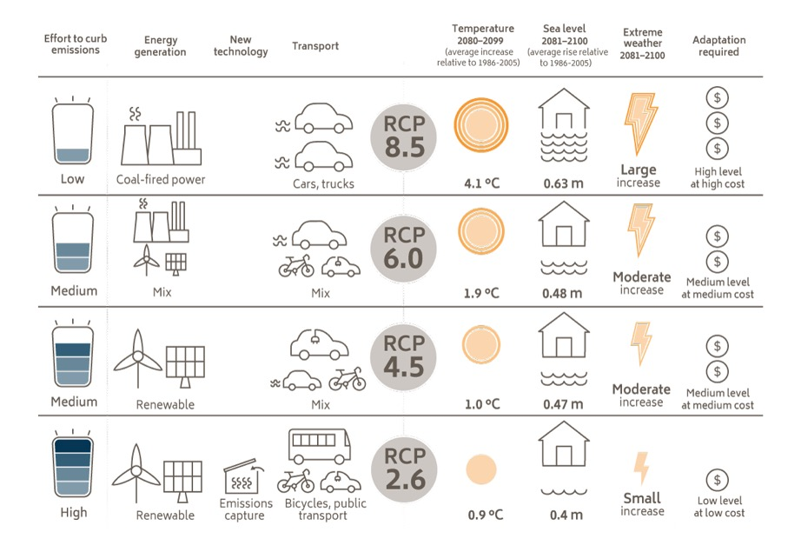
Business as usual
Low emissions scenario
A brave new world
Notes:
These scenarios also imply significant changes to our energy mix across any sectors, and trace-offs between transition risk (mitigation) and physical risk (impacts): A high emissions scenario would imply high use of coal and internal combustion engines, but more warming, sea-level rise and other changes, and expensive adaptation. A low emissions scenario requires more investment in low-emissions energy, but less physical risk and less investment in adaptation.

Slide 5
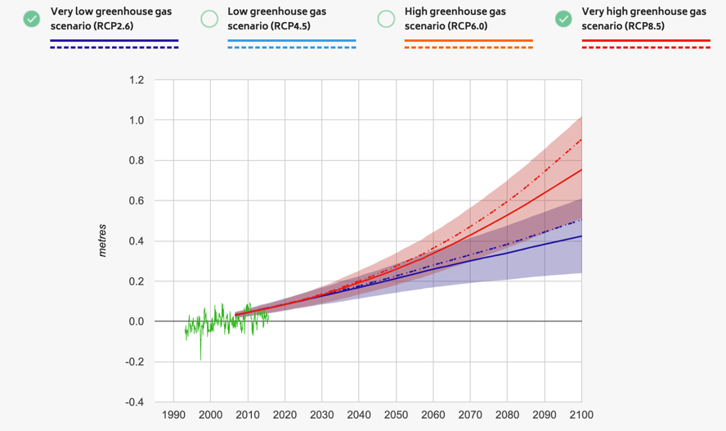
TIME PERIODS AND DECISION LIFETIME
Important to consider
time periods and the decision lifetime
of policy/project
Toward end of century, scenarios diverge considerably
Short-term project, little difference between emissions scenarios
Sea level rise, Townsville
www.coastadapt.com.au
Notes:
TIME PERIODS AND DECISION LIFETIME: It is Important to consider
time periods and the decision lifetime
of policy/project
For longer-term projects, the differences between different scenarios are more consequential, whereas for the shorter-term different scenarios do not stroingly diverge, as shown by this sea-level rise example for Townsville

Slide 6
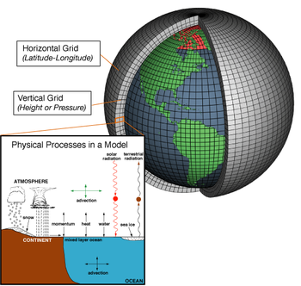
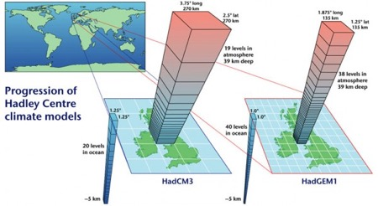
WHY DO PROJECTIONS VARY?
Different modelling groups
Oldest, most well-established scientific institutions: e.g. NOAA, CSIRO, Bureau of Meteorology
Climate information comes from experimental models
Modelling techniques continually refined
Some models better at some aspects or regions
Projections use ‘ensembles’
www.climate.gov
Notes:
WHY DO PROJECTIONS VARY?
Climate models are numerical approximations of the climate system, attemting to simulate the physical processes of the atmosphere, ocean and cryosphere (ice). There are:
Different modelling groups
Oldest, most well-established scientific institutions: e.g. NOAA, CSIRO, Bureau of Meteorology
Climate information comes from experimental models
Modelling techniques continually refined
Some models better at some aspects or regions
Projections use ‘ensembles’ or multiple model projections to try to account for models’ different representation of climate processes.

Slide 7
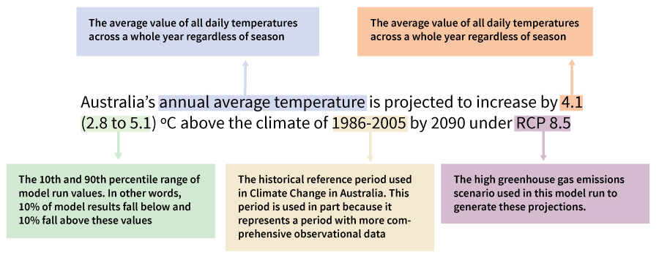
A LOT OF INFORMATION IN PROJECTION STATEMENTS
Models produce scenarios (not predictions)
Notes:
Models produce scenarios (not predictions) and can produce a lot of information: for example a national warming projection depends on the baseline period, the end period, the scenario used (high- or low-emissions), the season used (annual versus summer) and the model or models used.

Slide 8
WHAT PROJECTIONS CAN TELL YOU

Slide 9

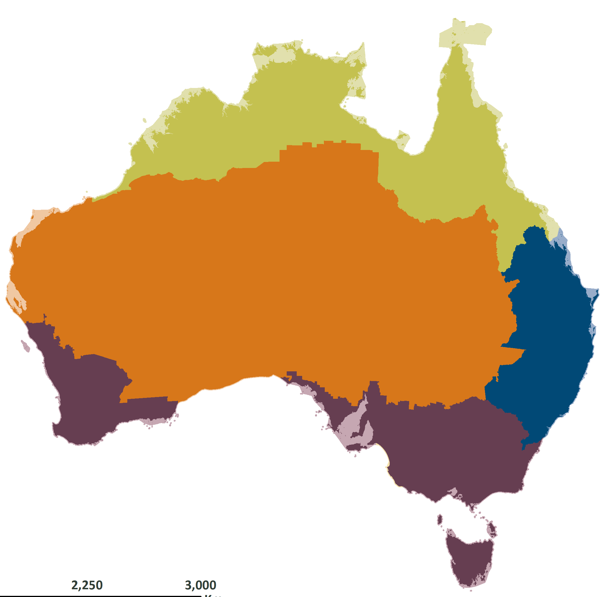
2.7 ← +3.7 ºC → 4.9
TEMPERATURE
INCREASE
2090
RCP8.5
2.9 ← +4.3 ºC → 5.3
2.8
↑
+3.9 ºC
↓
5.0
2.7 ← +3.5 ºC → 4.2
Changes are relative to 1986-2005
Notes:
Under a high emissions scenario, these are projected temperature increases for different regions in Australia. They all would warm but at different magnitudes. For example the centre of the continent would warm more than coastal regions,

Slide 10
GETTING THE INFORMATION …
Use the Climate Change in Australia ‘cheat sheet’ as a starting point
Also look at the decision tree on the website to help you find what you need
Notes:
Use the Climate Change in Australia ‘cheat sheet’ as a starting point
Also look at the decision tree on the website to help you find what you need

Slide 11
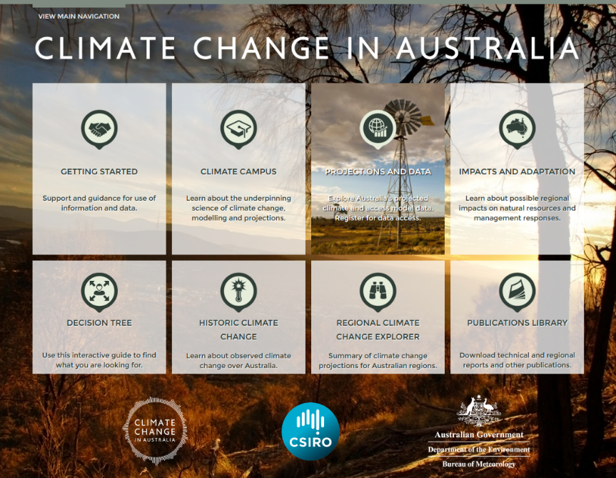
Notes:
Climate change in Australia remains the single most comprehensive source of climate information for adaptation

Slide 12
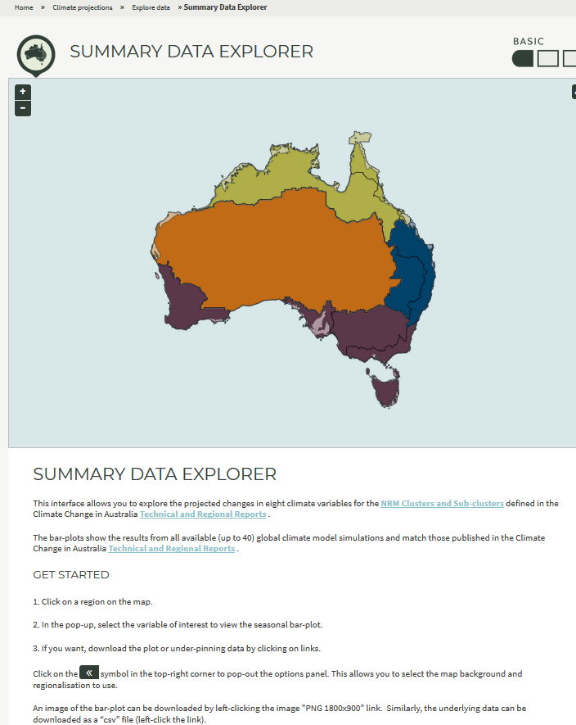
SUMMARY EXPLORERS
Obtain data on changes in mean climate
[Home » Climate Projections » Explore Data » Summary Data Explorer]
Notes:
You can get data on changes in mean climate using the Summary Data Explorer

Slide 13
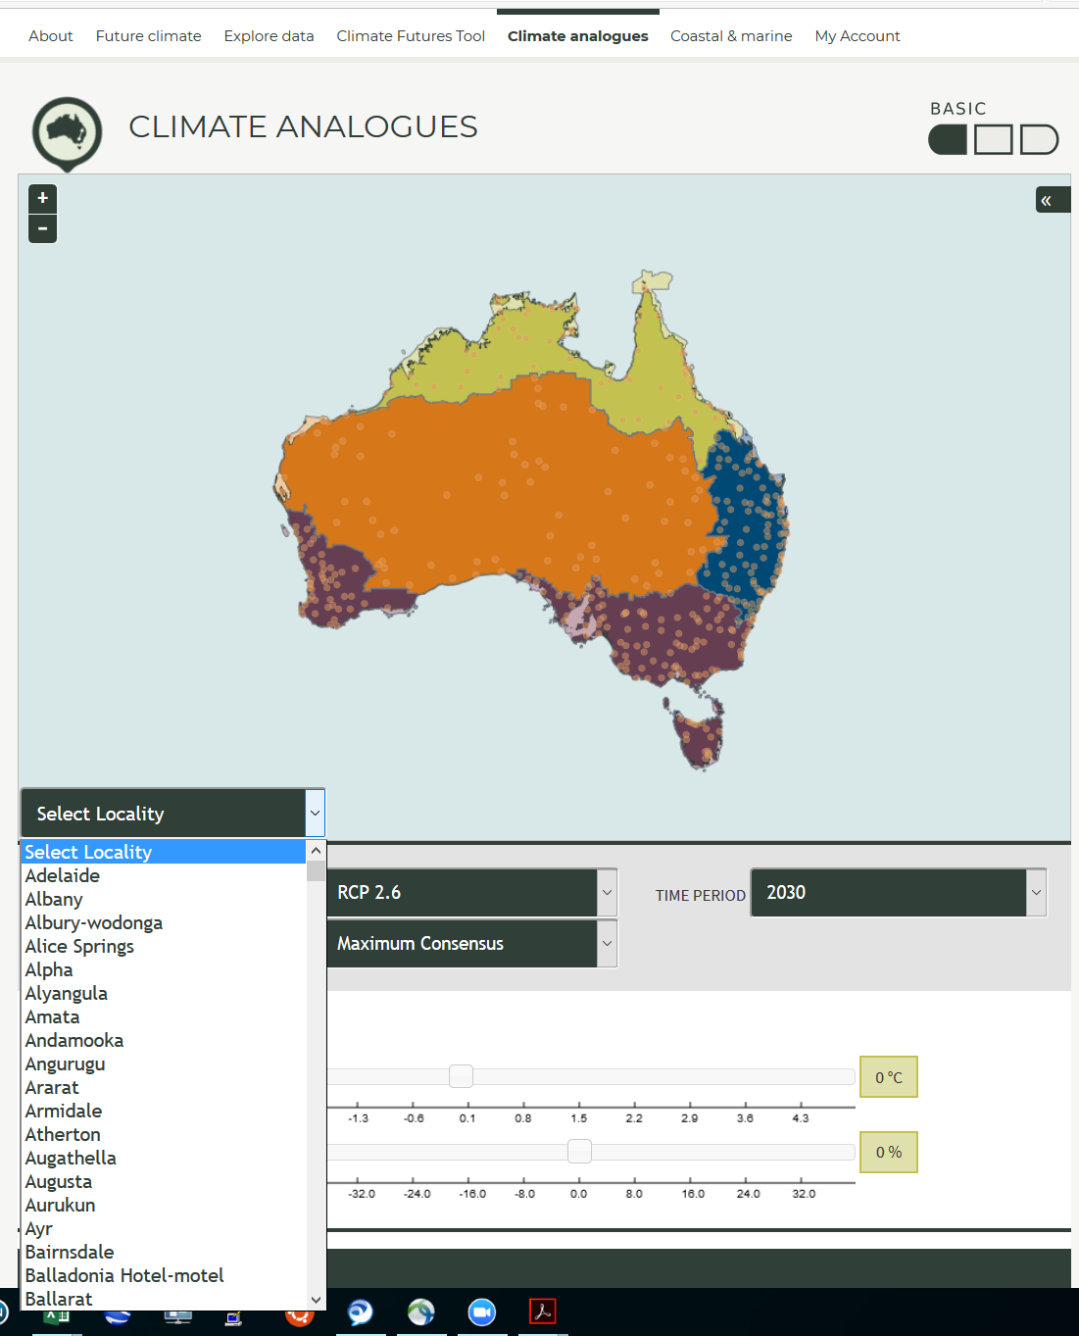
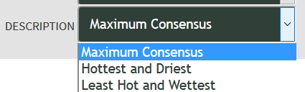
CLIMATE ANALOGUES
Can select:
Locality
Emissions scenario (RCP2.6, RCP4.5, RCP8.5)
Future scenario description
Time period (centred on 2030, 2050, or 2090)
[Home » Climate Projections » Climate analogues » Analogues Explorer]
Notes:
The Analogues Explorer tool provides the ability to gain a clearer understanding of what the future climate at a location is expected to be by equating it to the current climate at another location.
This provides future climate information in a way that is much easier to relate to.
By limiting the results to significant towns, there is a good chance the user has some appreciation of what the climate is like at the analogue location.
Users can use preset scenarios derived from the global climate model projections for different future scenarios of greenhouse gas emissions.

Slide 14
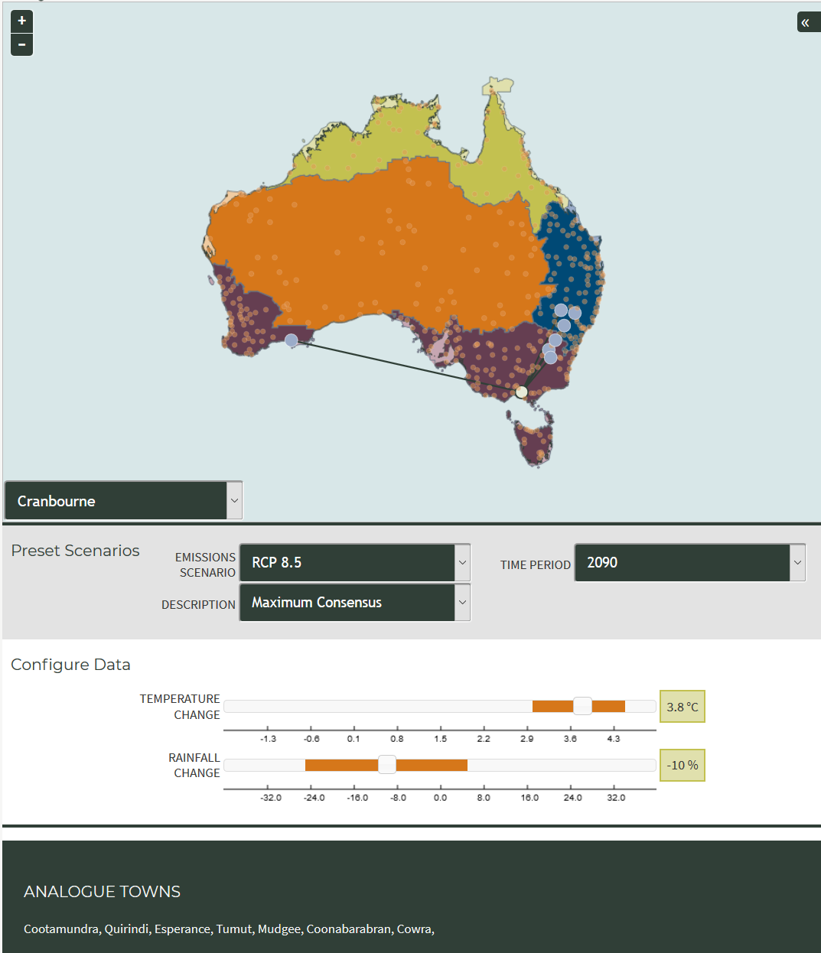
Using Cranbourne as an example, has identified seven Analogue towns – whose current climate could reflect Cranbourne’s in the future
Notes:
Using Cranbourne as an example, the analog explorerhas identified seven Analogue towns – whose current climate could reflect Cranbourne’s in the future, in a hig-emissions scenarion

Slide 15
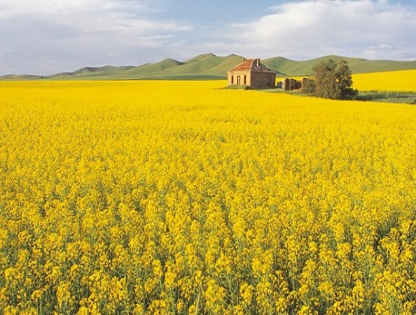
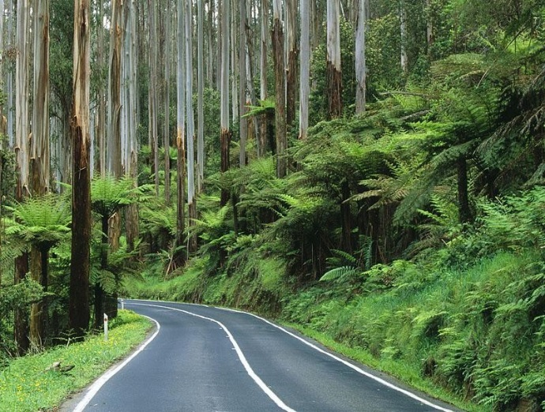
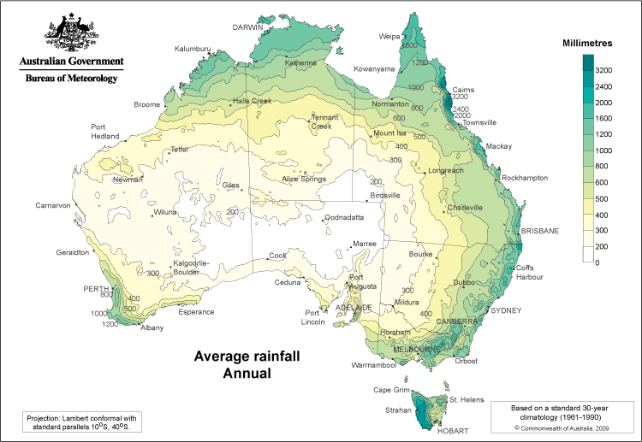
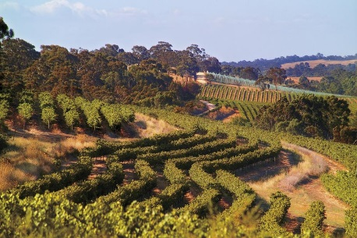
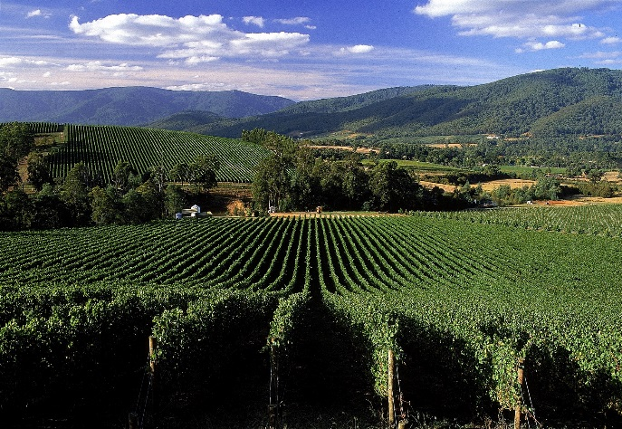
EXAMPLE CLIMATE ANALOGUES FOR MELBOURNE
Climatological rainfall map based on around 2 degrees of warming and more than 20% drier
Clare, South Australia
Melbourne, Victoria
Notes:
Melbourne would be more like Clare SA: also warmer and drier.

Slide 16
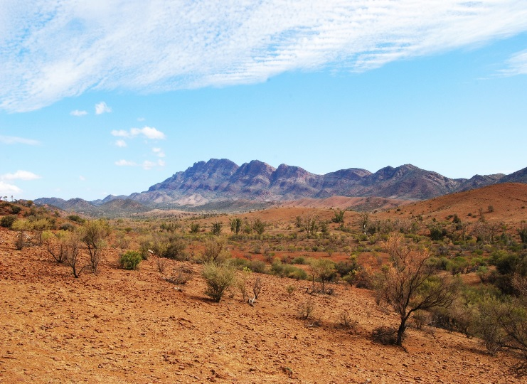
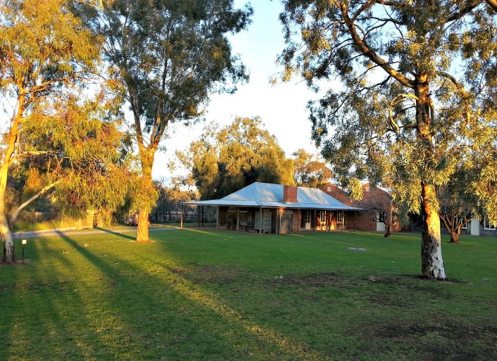
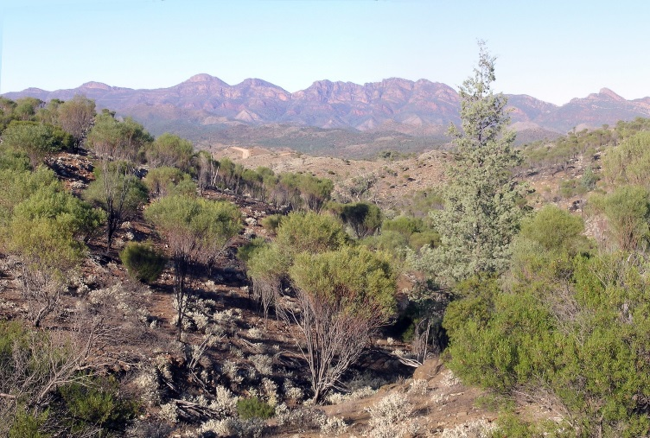
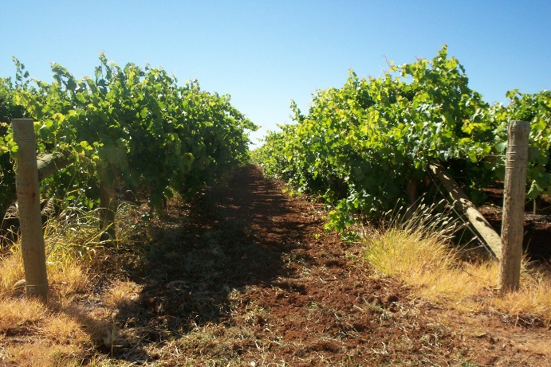
EXAMPLE: CLIMATE ANALOGUES FOR MILDURA
Flinders Ranges, SA
Climatological rainfall map based on around 2 degrees of warming and more than 10% drier
Mildura, Victoria
Notes:
CLIMATE ANALOGUES FOR MILDURA: Mildura would be more like Flinders Ranges are now: warmer and drier.

Slide 17
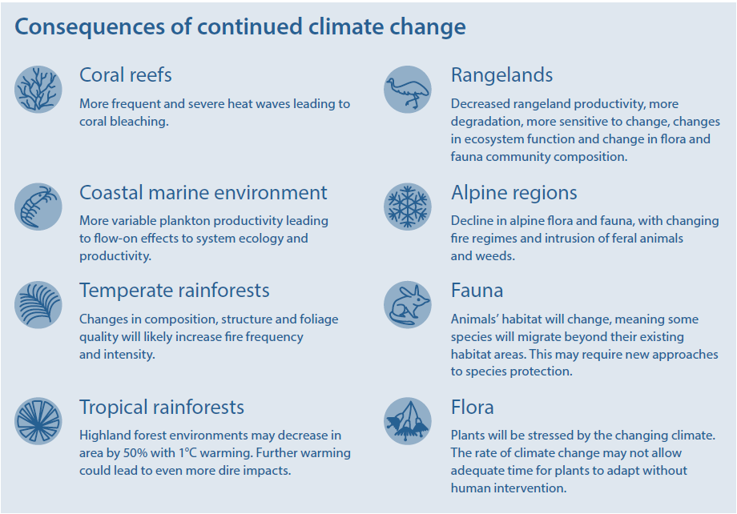
HOW WILL CLIMATE CHANGE AFFECT BIODIVERSITY?
Notes:
Climate change would also affect biodiversity, including the inpacts of more marine heatwaves on coral reefs: causing bleaching and coral deaths; greater fire weather frequency and intensity would affect temperate rainforests. Many of the changes are happening rapidly, challenging ecosystems’ and organisms’ ability to adapt.

Slide 18
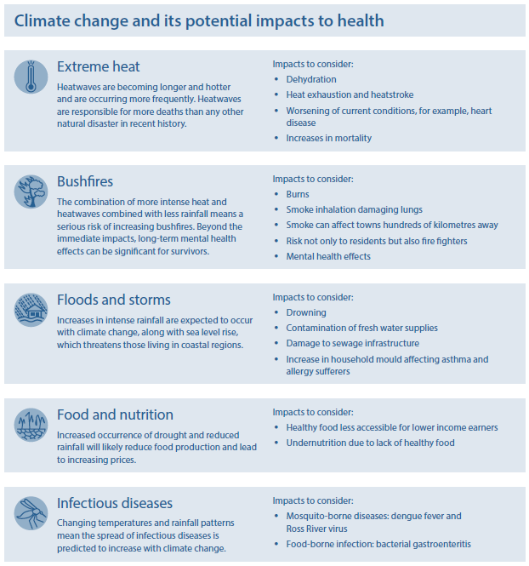
HOW WILL CLIMATE CHANGE AFFECT HEALTH?
Notes:
Climate change poses risk to human health, through greater incidence and intensity of extreme heat, more intense floods in some regions, and changes in the spraed of vector-borne diseases such as Dengue Fever

Slide 19
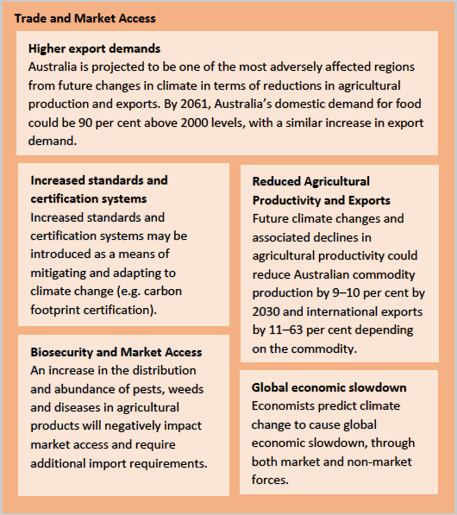
HOW WILL CLIMATE CHANGE AFFECT AGRICULTURE?
Notes:
CLImate change poses risk to agriculture, through shifts in rainfall patterns, changes in the ranges of pest and invasive species, and reduced productivity in some regions.

Slide 20
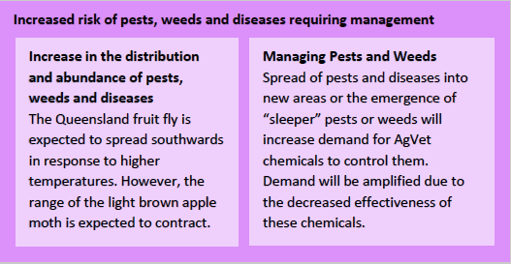
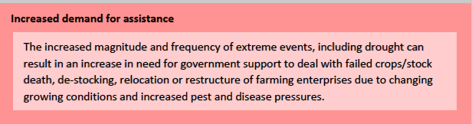
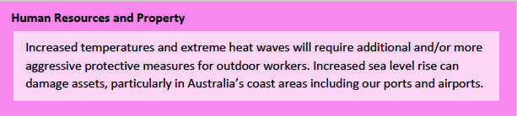
HOW WILL CLIMATE CHANGE AFFECT AGRICULTURE?

Slide 21
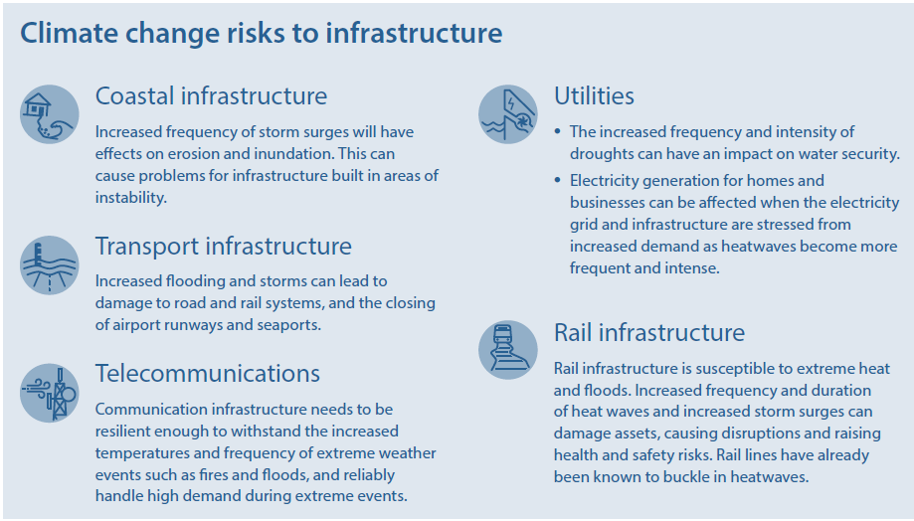
HOW WILL CLIMATE CHANGE AFFECT INFRASTRUCTURE?
Notes:
Infrastructure is put a t risk from rising sea levels, extremes in heat and flooding and bushfires. Droughts can affect water security for water distruibution networks and cooling for thermal power plants.

Slide 22
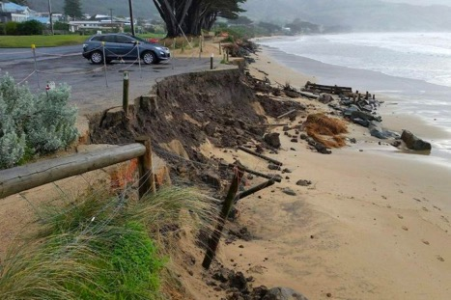
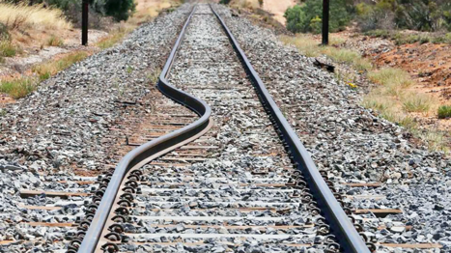
DIRECT PHYSICAL IMPACTS OF CLIMATE CHANGE
Major climate related damage (permanent or temporary) in extreme events:
    Coastal erosion and flooding (undermine structures, washout roads)
    Transport (rail buckling, road melting, bridge washout)
    Utilities (damage water processing or sewerage plants)
Notes:
DIRECT PHYSICAL IMPACTS OF CLIMATE CHANGE include:
Major climate related damage (permanent or temporary) in extreme events:
Coastal erosion and flooding (undermine structures, washout roads)
Transport (rail buckling, road melting, bridge washout)
Utilities (damage water processing or sewerage plants)

Slide 23
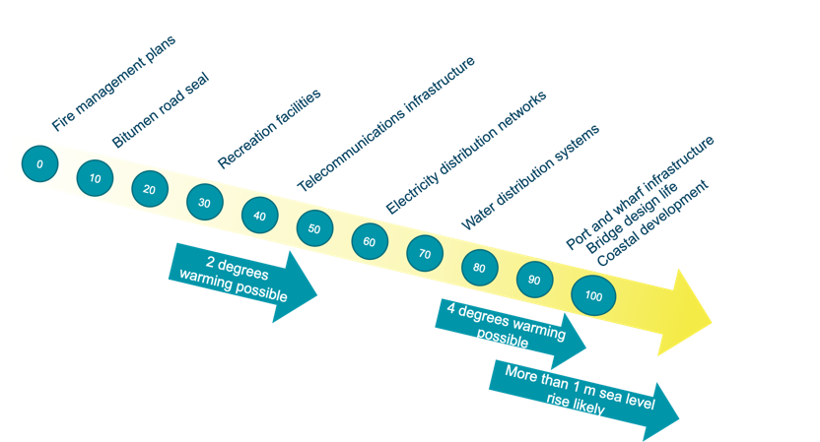
CHALLENGES FOR INFRASTRUCTURE SECTOR
Lifetime of some assets
Cross-sectoral
Financial
Notes:
CHALLENGES FOR the INFRASTRUCTURE SECTOR include risks to: Lifetime of some assets
Cross-sectoral
Financial
These risk depend on part on the lifetime of assets and the degree and extent of warming, sea-level rise and other impacts.

Slide 24
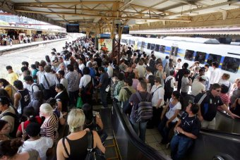
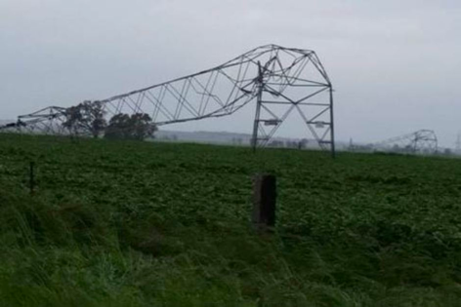
INDIRECT AND FLOW-ON IMPACTS OF CLIMATE CHANGE
Interruption to services and supply
Financial costs
Reputational
Legal risks
Health and safety
Notes:
INDIRECT AND FLOW-ON IMPACTS OF CLIMATE CHANGE can include:
Interruption to services and supply
Financial costs
Reputational
Legal risks
Health and safety

