Slide 1
INTERNATIONAL POLICY
& STRATEGIES FACULTY
INTRODUCTION TO CLIMATE SCIENCE
CLIMATE SCIENCE, RISK AND ADAPTATION PATHWAYS

Slide 2
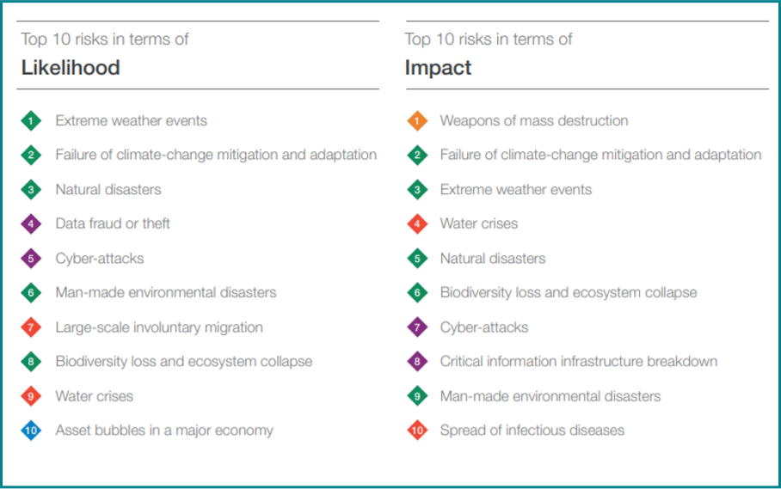
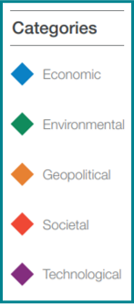
WORLD ECONOMIC FORUM GLOBAL RISK REPORT 2019

Slide 3
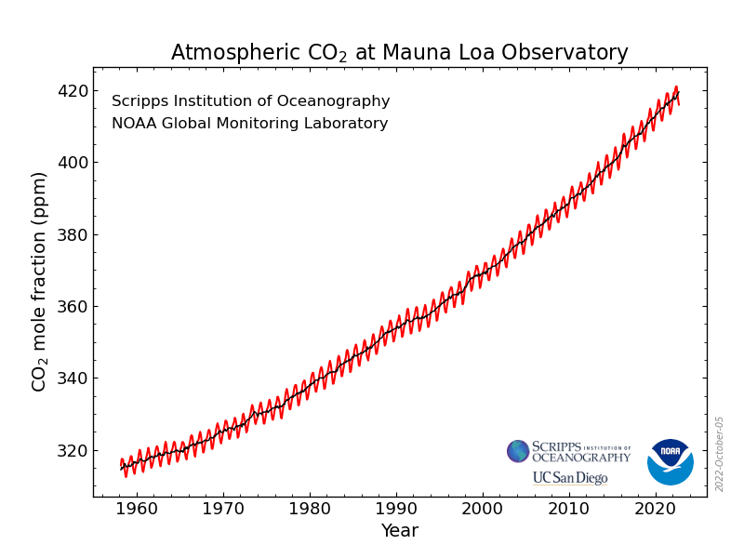
GREENHOUSE GASES (‘GHGs’)HAVE INCREASED …
Carbon dioxide(CO₂) concentrations have increased about 50% over preindustrial levels, due to human activity, mainly due to fossil fuel use
Other GHGs have also risen: methane, nitrous oxide and CFCs
Notes:
Carbon dioxide(CO₂) concentrations have increased about 50% over preindustrial levels, due to human activity, mainly due to fossil fuel use
Other GHGs have also risen: methane, nitrous oxide and CFCs

Slide 4
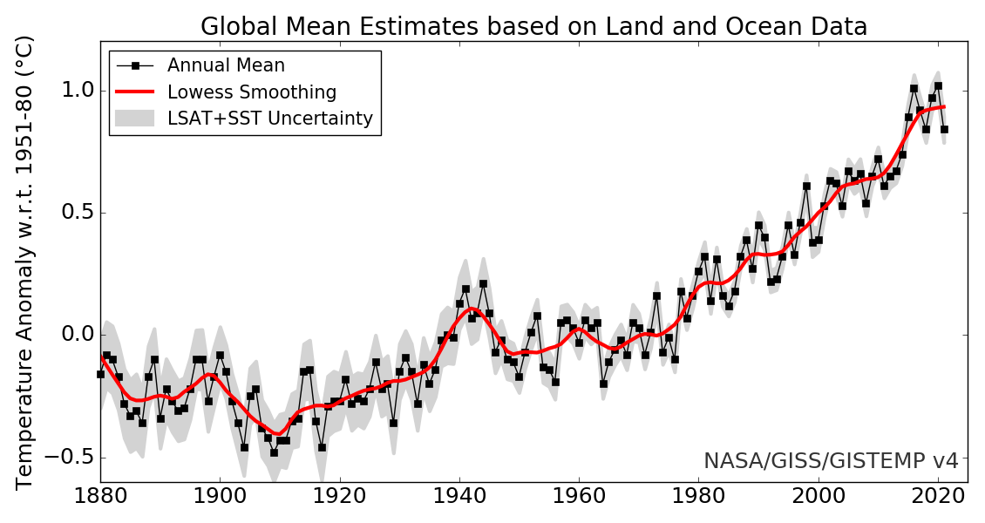
THE EARTH HAS WARMED …
The Earth has warmed
by about 1.1 degrees Celsius on average since the late 1800s,
largely due to GHGs.
Notes:
The Earth has warmed
by about 1.1 degrees Celsius on average since the late 1800s,
largely due to GHGs.

Slide 5
HOW DO WE KNOW THIS IS DUE TO CLIMATE CHANGE?
The models show that
today’s climate can’t
be properly simulated
without including the
influence of human
carbon dioxide emissions
Notes:
HOW DO WE KNOW THIS IS DUE TO CLIMATE CHANGE?
The models show that
today’s climate can’t
be properly simulated
without including the
influence of human
carbon dioxide emissions. Though there are natural influences on climate, human influences have grown to dominate over the natural influences.

Slide 6
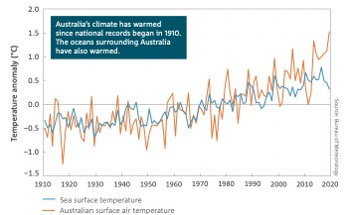
AUSTRALIA HAS ALSO WARMED …
Australia has also warmed by about 1 degree Celsius on average.
Since the 1950’s each decade has been warmer, on average, than the one before it.
We know this from over
100 years of temperature measurements by the
Bureau of Meteorology
Notes:
Australia has also warmed by about 1 degree Celsius on average.
Since the 1950’s each decade has been warmer, on average, than the one before it.
We know this from over
100 years of temperature measurements by the
Bureau of Meteorology

Slide 7
WHAT HAVE WE SEEN SO FAR?
Extreme high temperature days across Australia
Trend since 1978 in high fire danger days
State of the Climate Report, BoM and CSIRO
Notes:
Extreme high temperature days and high fire danger days have increased over recent decades; both manifestations of warming. These increase the risk of dangerous impacts to human health and ecosystems.

Slide 8
WHAT HAVE WE SEEN SO FAR?
Australian cool season rainfall (BoM)
Southwest WA rainfall (BoM)
Notes:
Australian rainfall has increased across northern Australia and decreased across southwest and southeast Australia. This change in geographical and seasonal rainfall patterns creates risks for agriculture across the southern parts of the continent. This pattern is particularly pronounced in southwest WA. Climate models indicate this change in rainfall patterns is influenced by climate change.

Slide 9
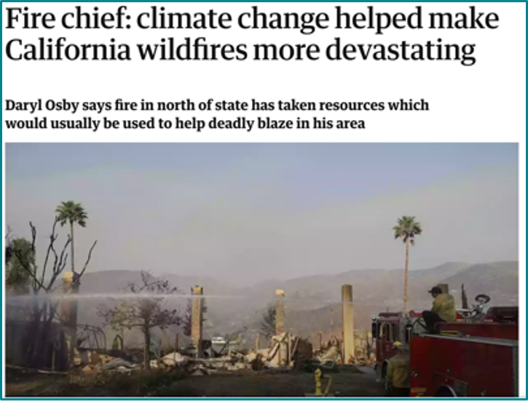
ARE CURRENT EXTREME WEATHER EVENTS
“CLIMATE CHANGE”?
Climate is about trends and averages – takes time to detect
We often know direction of
change (e.g. hotter)
Changed conditions (e.g. sea surface temp.) increase the
odds of extreme weather
Many present-day extreme weather events provide a preview of the future
Notes:
ARE CURRENT EXTREME WEATHER EVENTS
“CLIMATE CHANGE”?
Climate is about trends and averages – takes time to detect
We often know direction of
change (e.g. hotter)
Changed conditions (e.g. sea surface temp.) increase the
odds of extreme weather
Many present-day extreme weather events provide a preview of the future

Slide 10
WHAT CAN WE EXPECT IN THE FUTURE?
Notes:
Understanding climate history, and drawing insights from climate models, provides projections of likely trends if GHG emissions and warming continue.
These include:
Continued warming
Continued sea-level rise
More heatwaves on land and sea
More probability of heavy rainfall, when it does rain
More dangerous fire weather and longer fire seasons
Cool-season decrease in rainfall in the southeast and southwest are likely to continue
We are likely to see fewer tropical cyclones, but those we see are more likely to be higher-intensity

Slide 11
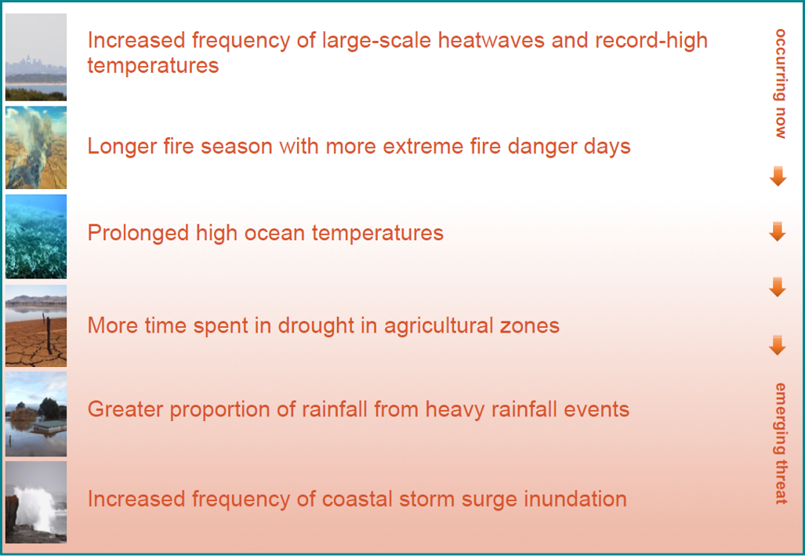

Slide 12

WHAT IS LIKELY TO HAPPEN NEXT: ATMOSPHERIC CO₂
Extra warming is already ‘locked in’ to the climate system due to slow-acting behaviour of oceans and ice sheets.
All IPCC pathways indicate 1.5°C of warming, possibly in the early 2030s.
The impacts we will experience longer-term
depend on the pathway
followed by global emissions.
2013 was a very hot year
(at the time), but by 2040,
this will become a cool year.
Notes:
Extra warming is already ‘locked in’ to the climate system due to slow-acting behavior of oceans and ice sheets.
All IPCC pathways indicate 1.5°C of warming, possibly in the early 2030s.
The impacts we will experience longer-term
depend on the pathway
followed by global emissions.
2013 was a very hot year
(at the time), but by 2040,
this will become a cool year.

