Slide 1
INTERNATIONAL POLICY
& STRATEGIES FACULTY
RISK AND ADAPTATIONS
CLIMATE SCIENCE, RISK AND ADAPTATION PATHWAYS

Slide 2
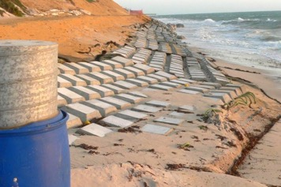
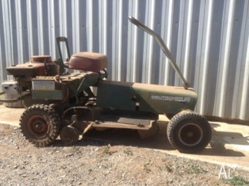
DEALING WITH THE RISK
Avoid the risk
Don’t build in flood risk area
Treat the risk
Engineered protection (e.g. seawall)
Raise vulnerable assets above flood level
Transfer/share the risk
Consider local plans and actions
Accept risk

Slide 3
THE RATIONALE FOR ADAPTATION
‘Past performance is not a reliable indicator of future performance’ Aust Securities & Investment Commission
‘The past climate is no longer a reliable indicator of the future climate’ Message from scientific community
Not matching the policy or strategy to changing climate, results in either underperformance and/or increasing risk

Slide 4
CLIMATE ADAPTATION
Adaptation: ‘Changing what we do to get what we want’
Lots of options: operational, strategic, asset-protection
Often some upfront cost (resources, knowledge, institutions)
But longer term expected benefits
Uncertain effectiveness (generally about 15 to 20% better off than otherwise) as highly contextual
But usually not complete removal of additional risk imposed by climate change impacts
‘Loss and damage’ agenda (read ‘residual vulnerability’)
Howden et al. 2007, 2013

Slide 5
MOVING FROM CLIMATE-CENTRIC APPROACH …
Economic development
Food
Climate change
Trade
Water
Livelihoods
Settlements
Biodiversity
Infrastructure

Slide 6
… TO A DECISION-CENTRIC APPROACH, RECOGNISING DECISIONS AND VALUES ARE KEY
Climate risk & adaptation
Trade
Food security
Economic development
Decisions, values, aspirations
Cities
Livelihoods
Biodiversity & heritage
Health
Education

Slide 7
MORE THAN MANAGING CLIMATE VARIABILITY
Managing climate variability is not the same as climate change adaptation
Focus on existing systems only may result in maladaptation
and in missed opportunities
Need to consider more systemic and transformational adaptations
increasingly so as changes continue
Transformational
Incremental
Systemic
Howden et al. 2010; Park et al. 2012; Rickards and Howden 2012

Slide 8
SOCIAL ASPECTS AND PSYCHOLOGY
Social, psychological and institutional aspects are crucial in terms of:
motivation
capacity
intent
But also in relation to barriers and limits to action
Adaptation journey – people start with the technical and tactical but end up focusing on strategy and values
Empowerment is critical – aligning values and taking action reduces stress

Slide 9
THE CHOICES WE MAKE TODAY MATTER
Annual crops,
fire management plans
Today’s decisions and their lifetimes
Emergency Mgmt planning
Road surface maintenance
Adaptation options change from autonomous and incremental to planned and transformative
New land purchases
0
0
Building standards
10
Communication networks
10
Hospital construction
20
20
30
Energy infrastructure
30
2°C warming very likely
40
40
50
50
Major dams, water provision
60
60
Suburb locations
4°C warming possible
70
70
80
80
90
Must account for how long their effects will be felt
90
100
100

